Slide 1

Capstone Update
Hongyu Dai
Jan 23

Slide 2
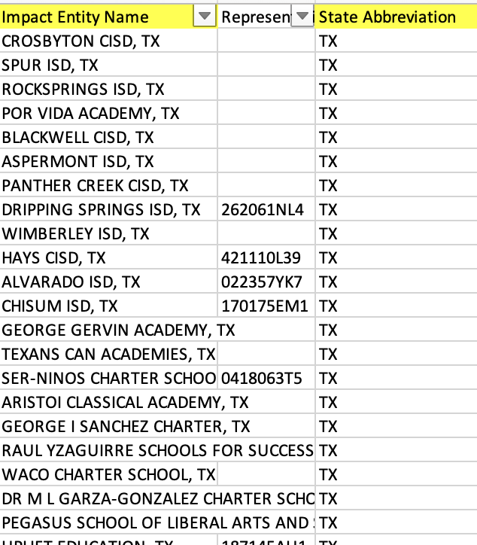
Current Progress —— Web Scrap
Able to get all excel report for school years: 2021-22, 2020-21, and 2018-19
All here means: all TX Impact Entity Name in K_12_HIPinvestor.csv

Slide 3
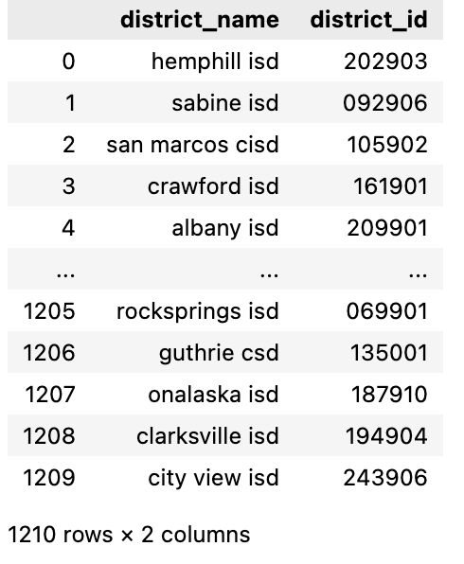
Method
Find District information in Texas Education Agency Public Open Data Site
-> able to download as csv
Data processing for both csv file
Left merge with our K12.csv
Conclusion: All school district id in Texas have been found (1210 district id in total.)

Slide 4
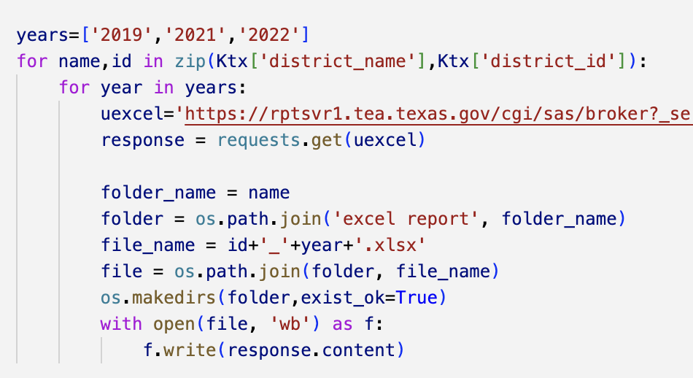
Method
Analyze the source code of the website to identify commonalities in the download links
-> use Python to download Excel reports

Slide 5
Question
How should we deal with the excel report?
How to name a file
How to set the path
Should we deal with the data right now?
Should I web scrap all file to my local computer? Or is there any server to run the code & save them?

Slide 6
Next Step
Using Azure Form Recognizer to extract tables from pdf report
Able to connect and download JSON data via Python
Question: only able to analyze 2 pages due to free version?
Don’t know how to convert this into a well-format DataFrame yet.

Slide 7
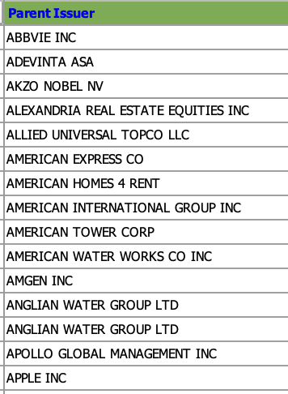
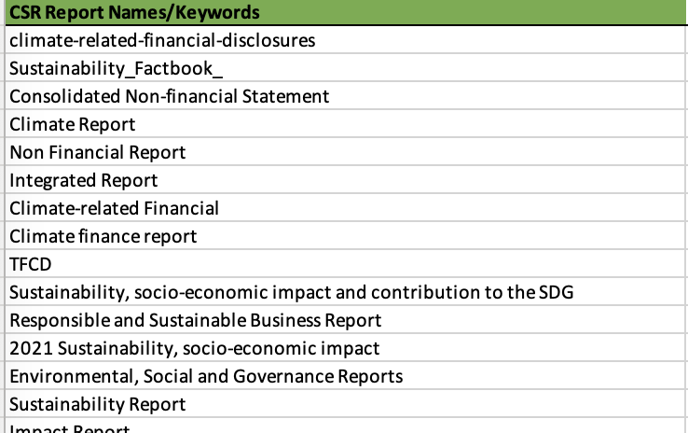
Next Step
Using a series of keywords to find the relevant CSR report for Parent Issuers
Based on Google Search?
Plan to start

